Slide 1
UMD DATA605 - Big Data Systems Graph Data Management
Neo4J
GP Saggese
gsaggese@umd.edu
with thanks to
Amol Deshpande,
R. Licher (Technion)
S. Nagarajan (U. Texas)

Slide 2
Overview
Graph
Motivation
Graph data model
Query vs analysis / tasks
Storing graph data

Slide 3
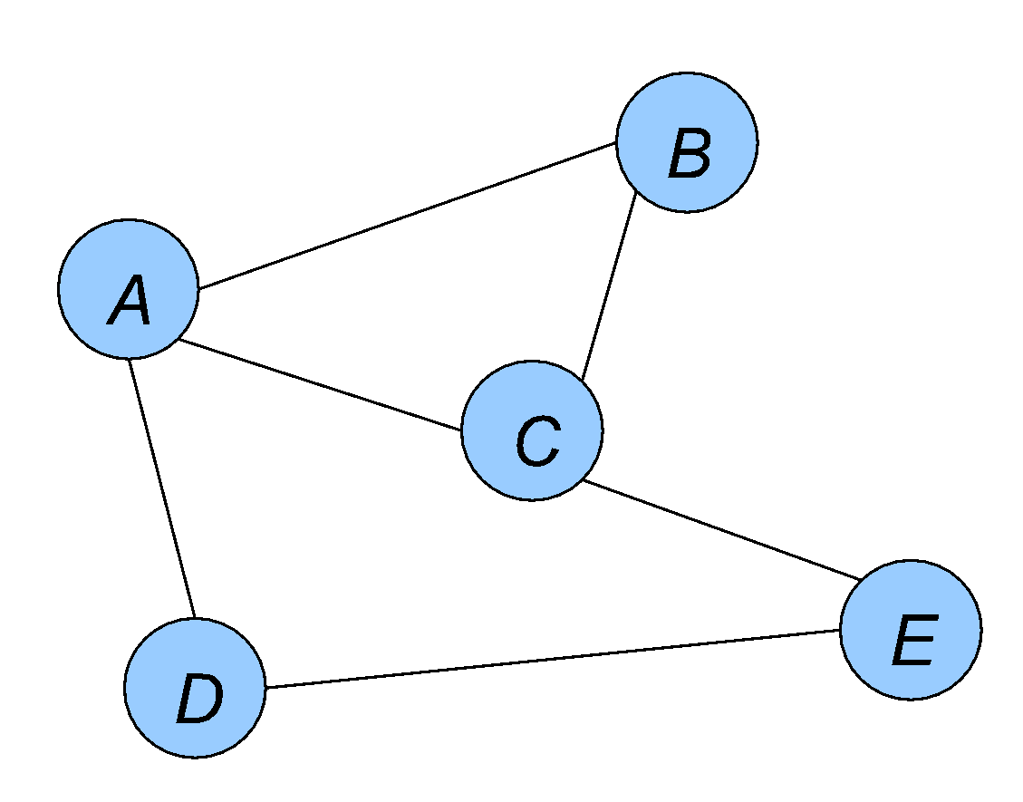
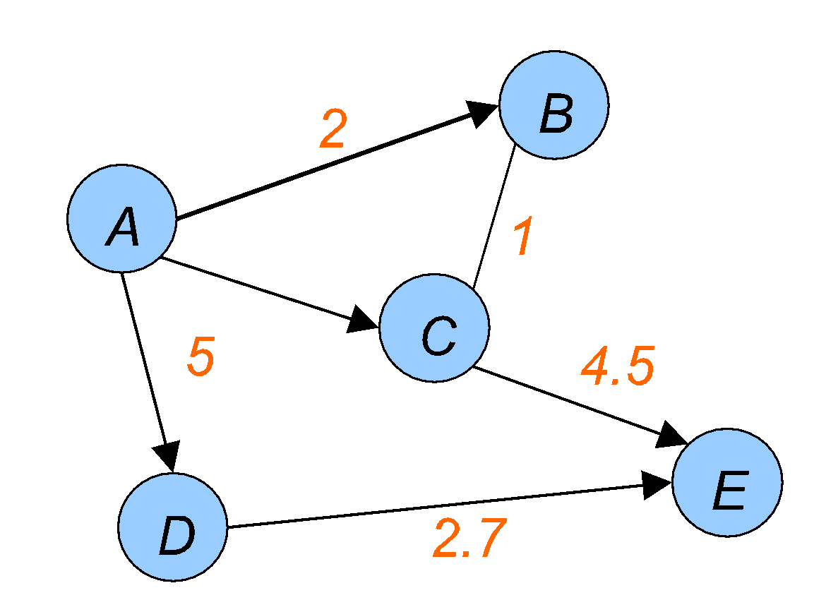
Background: Graphs
A graph captures a set of entities and interconnections between pairs of them
Graphs also often called networks
Entities/objects represented by vertices or nodes
Interconnections between pairs of vertices called edges
Also called links, arcs, relationships
An undirected, unweighted graph
A directed, edge-weighted graph

Slide 4
Background: Graphs
Graph theory and graph algorithms very well studied in Computer Science
Not as much work on managing graph-structured data

Slide 5
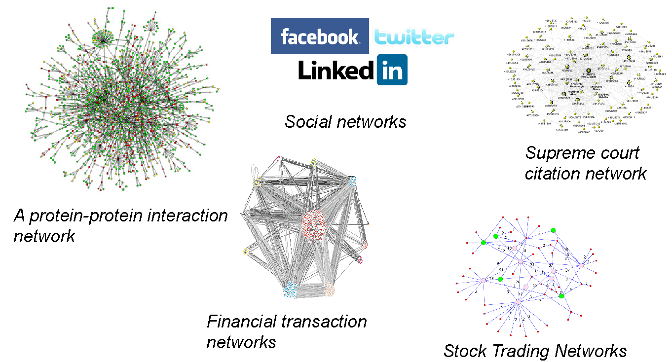
Motivation
Increasing interest in querying and reasoning about the underlying graph structure in a variety of disciplines

Slide 6
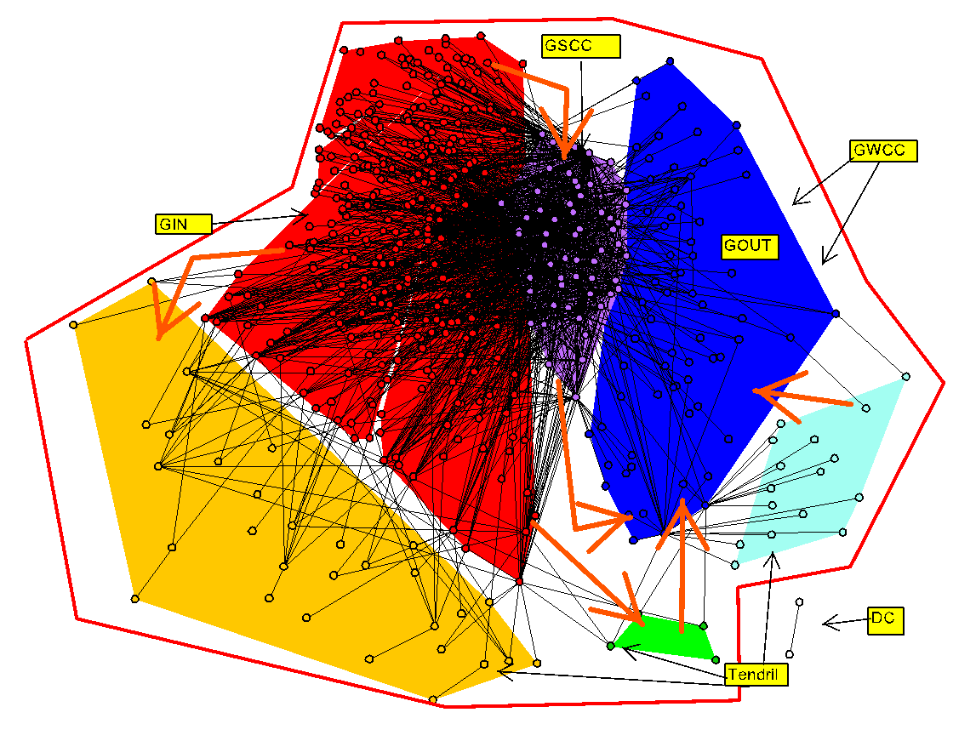
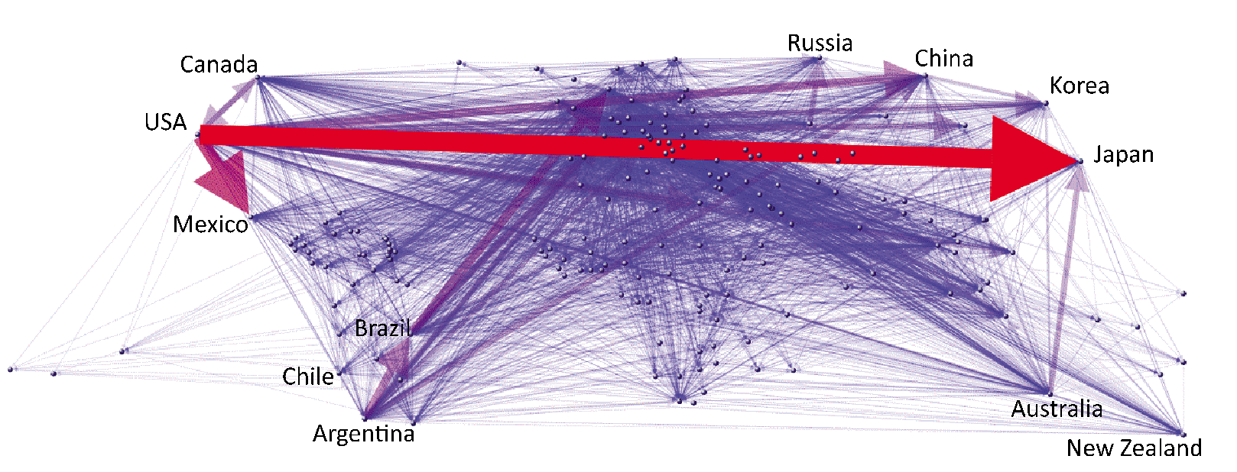
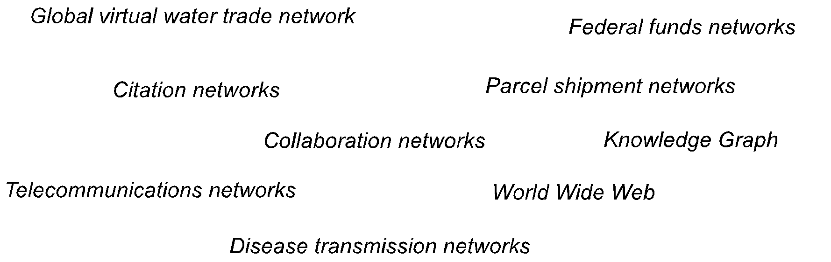
Motivation

Slide 7
Motivation
Underlying data hasn’t necessarily changed that much
Aside from the data volumes and easier availability
However, several new realizations in recent years:
Reasoning about the graph structure can provide useful and actionable insights (network science/complex network analysis)
Lose too much information and intuitions if graph structure ignored
Not easy to write many natural queries or tasks using traditional tools
Especially relational databases like Oracle, PostgreSQL
Harder to efficiently process inherently graph-structured queries or complex network analysis tasks using existing tools
A major concern with increasingly large graphs seen in practice

Slide 8
Overview
Goal: Manage graph-structured data
Store data containing a set of entities and interconnections between them
Execute various types of network analysis queries over them
Specific graph analytics techniques we will discuss (later):
PageRank: the slides have a somewhat detailed description
Betweenness Centrality: only the basic idea, not the algorithms
Community Detection: some basic intuitions about it

Slide 9
Overview
Vertex-centric programming framework
Originally Google's Pregel System
Adopted (with some variations) by many other systems including Giraph, GraphLab, etc.
(Apache) Giraph programming framework
Based on Hadoop (and hence on Map-Reduce)
Originally a Facebook project
Claims to support computations on graphs with a trillion edges
Graph-centric programming model

Slide 10
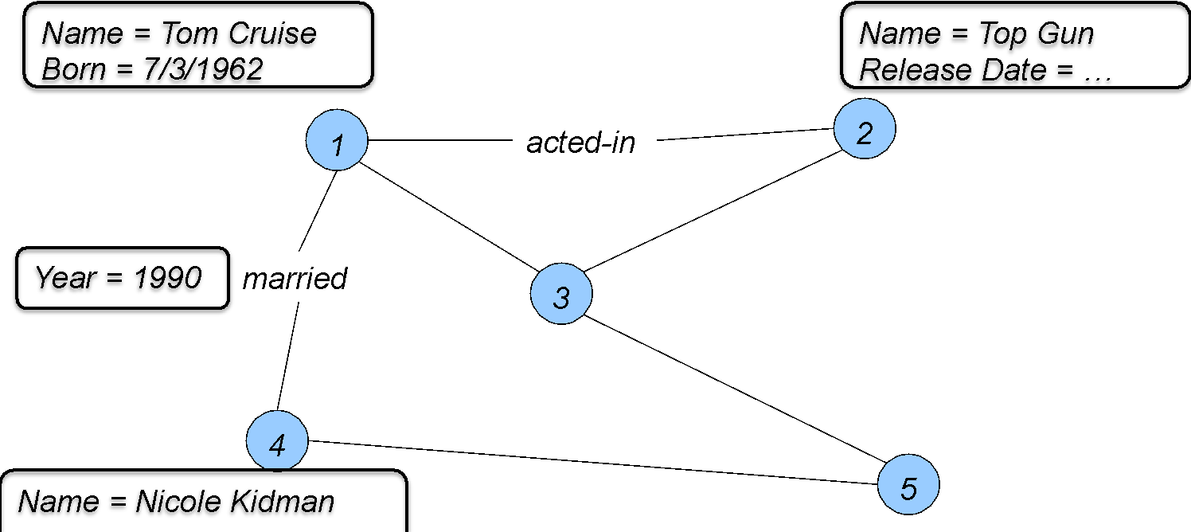
Graph Data Models: Property Graph
Property Graphs
Aka “labeled property graphs”
A directed graph where each node and each edge may be associated with a set of properties
Used by many open-source graph data management tools

Slide 11
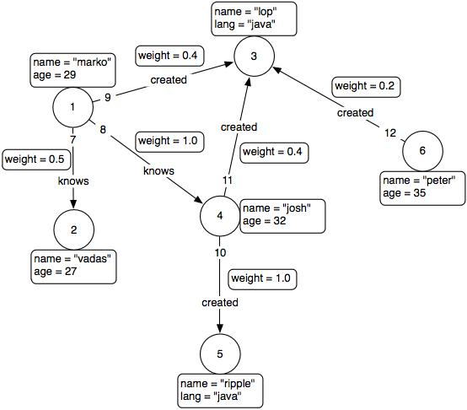
Graph Data Models: Property Graph
Property Graph Model

Slide 12
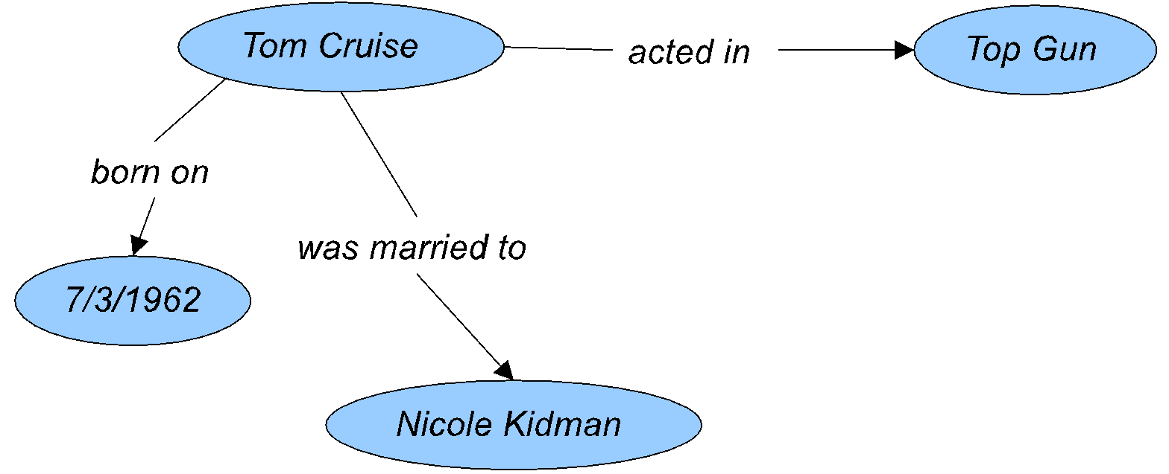
Graph Data Models: RDF
Resource Description Framework (RDF)
Each edge (called a triple) connects a “subject”, an “object”, and is associated with a “predicate”
E.g., “TomCruise-acted-TopGun”
Used data model for representing knowledge bases
Standard W3C to model data
Subject and object can be URI (Uniform Resource Identifier) in semantic web
Interoperable: can merge RDF data store

Slide 13
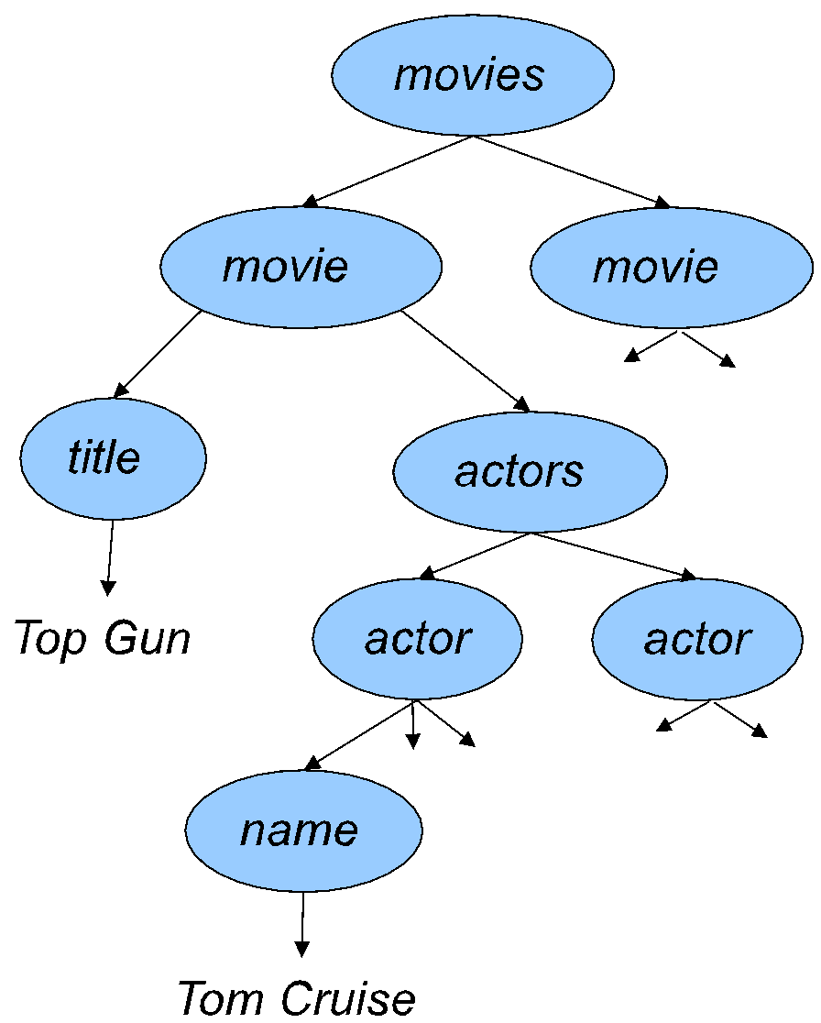
Graph Data Models: XML
Commonly used data model for representing data without rigid structure
In essence: a directed labeled “tree”
Popular data exchange format
<movies> <movie> <title>Top Gun</title> <actors> <actor> <name>Tom Cruise</name> <born>ti/3/1962</born> </actor> <actor> … </actor> </actors </movie>
…

Slide 14
Queries vs. Analysis Tasks
Queries:
Focused exploration of the data
Result is typically a small portion of the graph (often just a node)
Challenges:
Minimize the portion of the graph that is explored
Heavy use of indexes (auxiliary data structures)
Analysis tasks:
Typically require processing the entire graph
Challenges:
How to handle the large volume of data efficiently
How to parallelize if the data doesn’t fit in memory of a single machine

Slide 15
Types of queries/tasks of interest
Subgraph pattern matching
Find matching instances of a given small graph in a large graph
Although technically NP-hard, usually the patterns are small
Shortest path queries
Find the shortest path between two given nodes
E.g., in road networks
Reachability
Given two nodes, is there an undirected or directed path between them?
Sometimes with constraints on the types of edges that can be used
Keyword search
Find the smallest subgraph that contains all the specified keywords
Historical queries
Given a node, find other nodes that evolved most similarly in the past
Graph algorithms
Network flows
Spanning trees

Slide 16
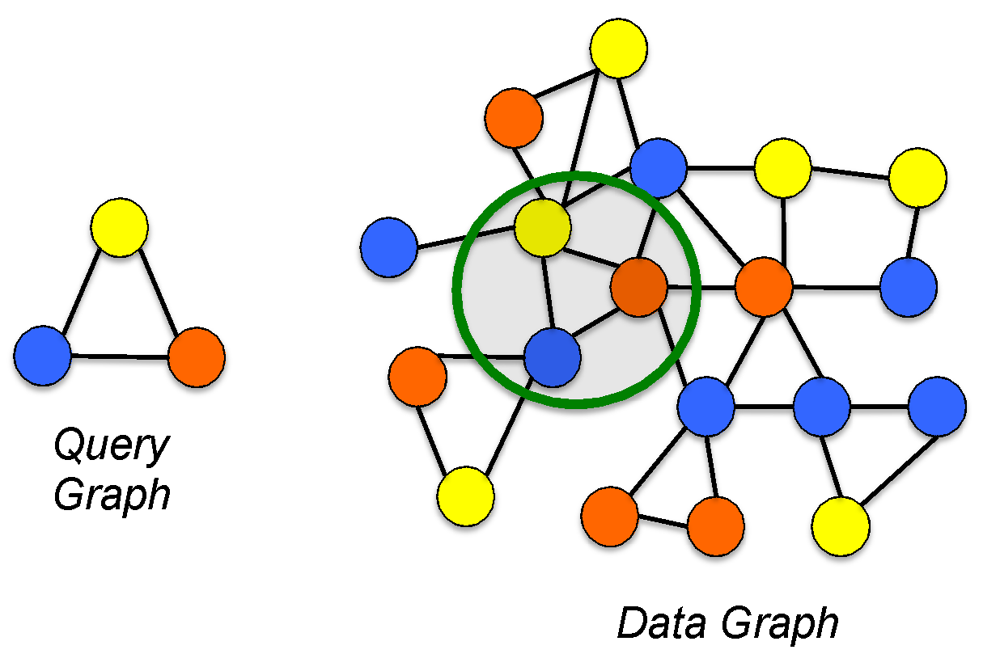
Queries: Subgraph Matching
Given a “query” graph, find where it occurs in a given “data” graph
Query graph can specify restrictions on the graph structure, on values of node attributes, and so on
An important variation: approximate matching
Alternatively, given a collection of data graphs, find the ones that contain the query graph

Slide 17
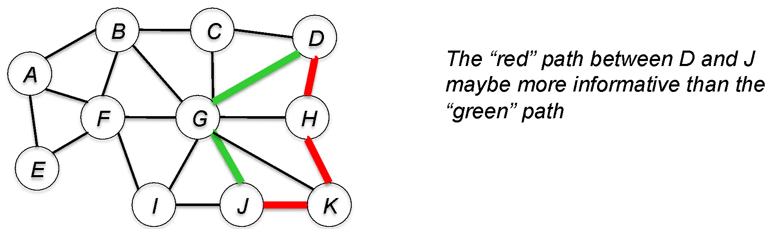
Queries: Connection Subgraphs
Given a data graph and two (or more) nodes in it, find a small subgraph that best captures the relationship between the nodes
Key question: How to define “best captures”?
E.g., “shortest path”: but that may not be most informative

Slide 18
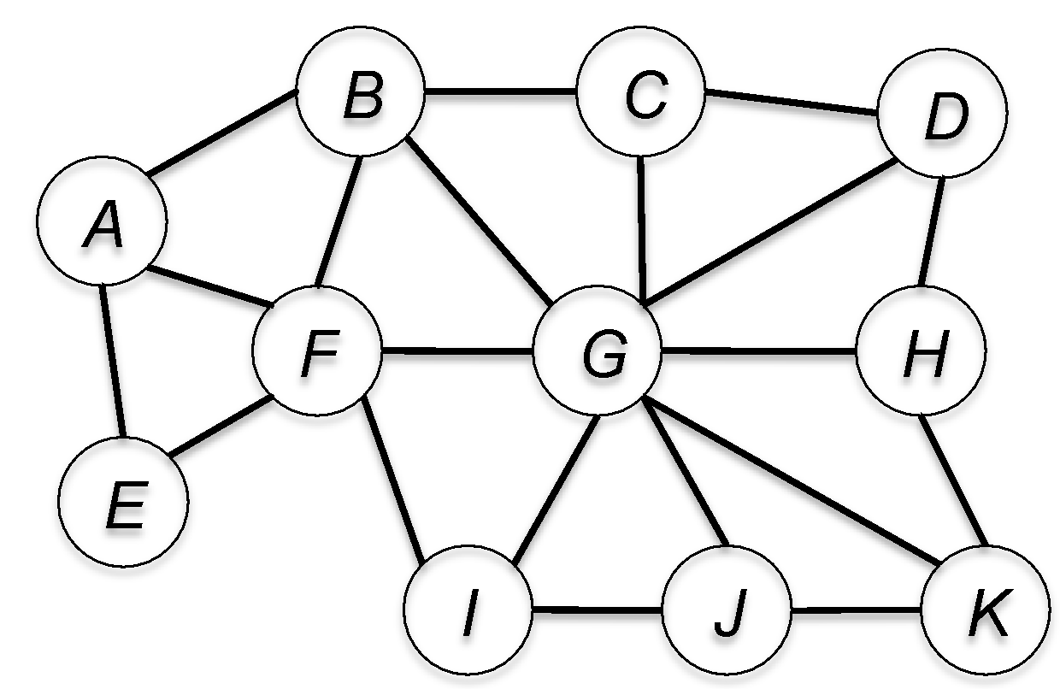
Graph Analysis: Centrality Measures
Centrality measure: a measure of the relative importance of a vertex within a graph
Many different centrality measures (can give fairly different results)
Degree centrality of a node u: # of edges incident on u
Betweenness centrality of a node u: # of shortest paths between pairs of vertices that go through u
Pagerank of a node u: probability that a random surfer
(who is following links randomly) ends up at node u
Eigenvector centrality: Used in a recent work on analyzing Federal Funds Network

Slide 19
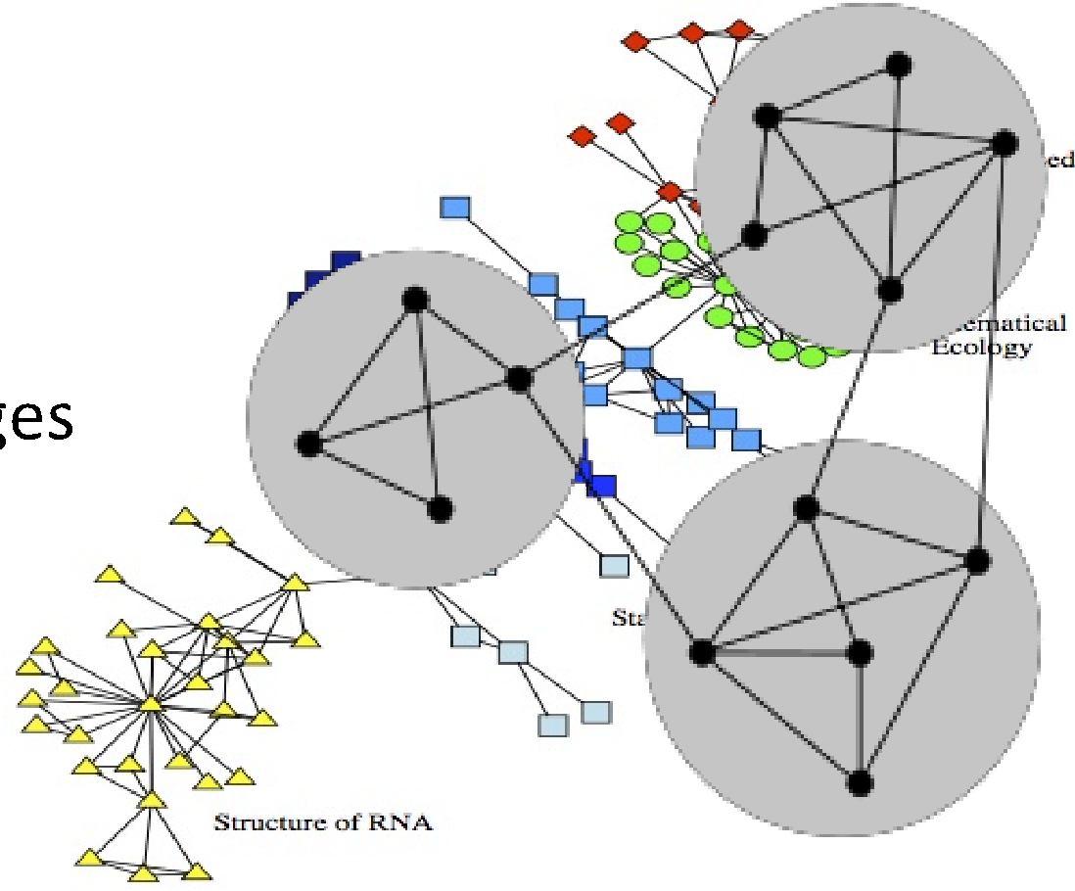
Graph Analysis: Community Detection
Goal: partitioning the vertices into (potentially overlapping) groups based on the interconnections between them
Basic intuition: More connections within a community than across communities
Provide insights into how networks function; identify functional modules; improve performance of Web services; etc.
Numerous techniques proposed for community detection over the years
Graph partitioning-based methods
Maximizing some “goodness” function
Recursively removing high centrality edges
And so on …

Slide 20
Graph Analysis: Models of Evolution
Two somewhat related goals:
Measuring different properties of networks
E.g., degree distributions, diameter, clustering coefficient, …
Using those to build models of how a network forms and evolves
To gain insights; for predictions about the future
Example:
Most real networks exhibit highly skewed degree distributions
Preferential attachment model explains that phenomenon
Basic idea: a new node is more likely to connect to a high-degree node than a low-degree node (“rich get richer”)
Some other observed properties:
Shrinking diameters
Average degree in the network increases over time
High clustering coefficients

Slide 21
Storing Graph Data
Use file systems + Very simple, and no (practical) limits on how large a dataset to manage - No support for transactions; minimal functionality
Use a relational database (e.g., Oracle, IBM DB2, PostgreSQL, etc.) + Mature technology – much of the data is already in them anyway + All the goodies (SQL, transactions, toolchains) available - Almost no support for traversing the graph structure
Use NoSQL key-value stores + Can handle very large datasets efficiently, in a distributed fashion - Minimal functionality – must build the analysis/querying tools on top
Use a persistent graph database + Efficiently support graph traversals - But even the most mature products not as a mature as RDBMSs - Often no declarative language (similar to SQL), so must write programs, but this has been getting better

Slide 22
Storage 1: File Systems
Simplest to get started and widely used in practice
Especially since the other options don’t really help that much anyway for graph querying or analytics
Many cloud computing programming frameworks read data from file systems
E.g., Hadoop Distributed File System (HDFS) used by Apache Hadoop and many others
Cons:
Almost no data management functionality
Everything from parsing to analyzing must be done by the programmer
No support for updates or transactions
Hard to do “queries” without building auxiliary structures

Slide 23
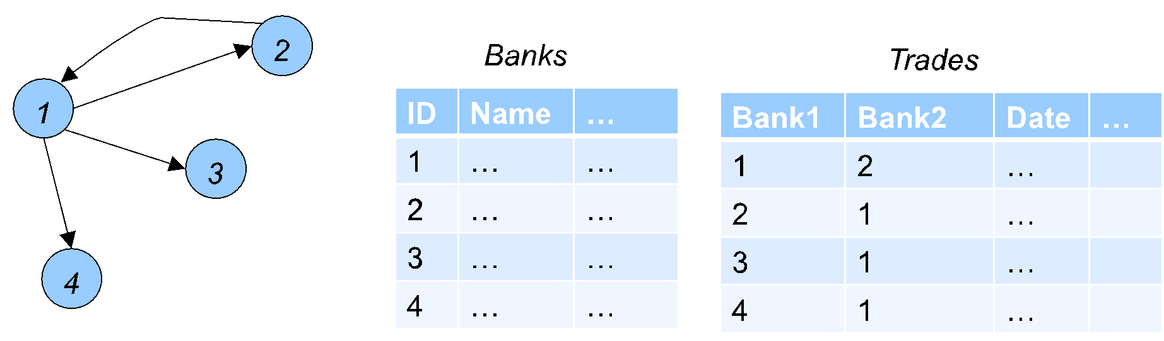
Storage 2: Relational Databases
Store the entities in a set of tables and encode the connections between them in separate tables
E.g., RDF and XML data predominantly stored in relational databases
Can use SQL to query the data and other analytic tools
However, no support for graph traversals
Must extract the relevant data and write code to construct/process the graph
Can be much much slower than specialized solutions for traversal operations

Slide 24
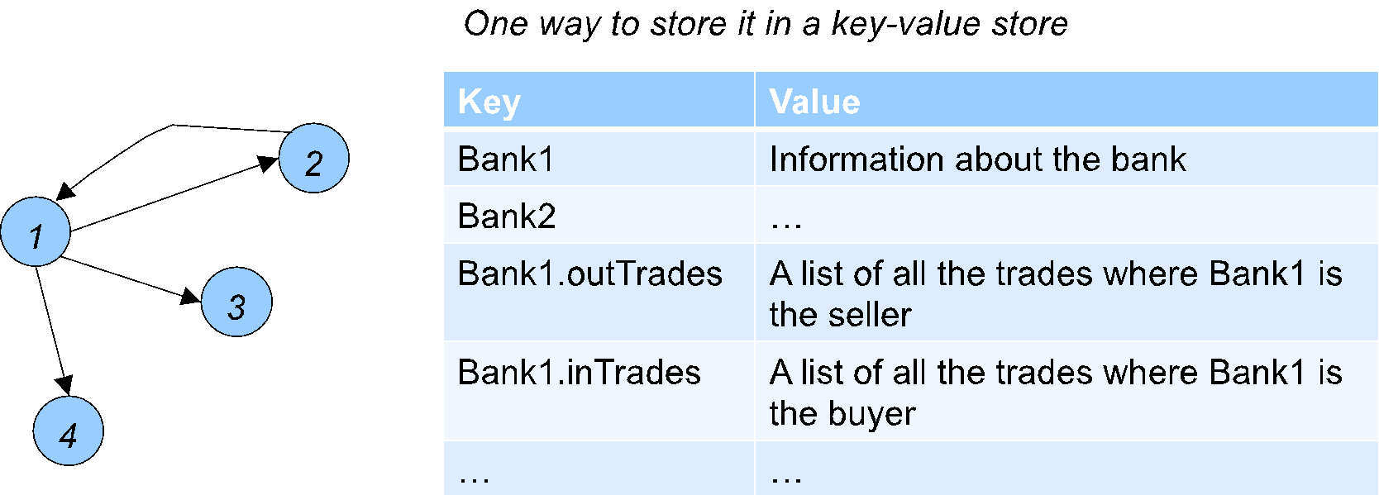
Storage 3: Key-value Stores
A very popular solution, to manage large datasets
E.g., Apache HBase, Cassandra, Amazon Dynamo, Redis
Very basic functionality
put(k, v): Store the value v, and associate it with key k
get(k): Get the value associated with key k

Slide 25
Storage 3: Key-value Stores
Key-value stores manage the data in a distributed fashion
Can handle very large datasets with very low latencies
Underlie many Web applications (many Google products, Facebook, etc.)
Pros:
Support efficient updates (must be careful about consistency)
Fast retrieval / easy to traverse the graph structure
Cons:
Everything outside of graph traversals must be built on top

Slide 26
Storage 4: Graph Databases
Many specialized graph database systems in recent years
E.g., Neo4j, Titan, OrientDB, DEX, Datomic
Many RDF stores support graph queries/analysis, e.g., AllegroGraph
An extensive list at the Wikipedia Article
A few key distinctions from relational databases
Support a graph query language like SPARQL, Cypher, Gremlin, or others
Store the graph structure explicitly as pointers
Avoid the need for joins, making graph traversals easier
More natural to write queries like reachability or shortest paths or other graph algorithms
Expose a programmatic API to write arbitrary graph algorithms

Slide 27
Storage 4: Graph Databases
Built to manage and query graph-structured data
Many built over the years, and increasing interest in recent years
InfiniteGraph: Originally an object-oriented database
DEX: Quite similar to Neo4j in functionality
AllegroGraph: An RDF database
HyperGraphDB: Allows modeling hypergraphs
Key disadvantages:
Fairly rudimentary declarative interfaces -- most applications need to be written using programmatic interfaces
Or using provided toolkits / libraries

Slide 28
More graph database systems
Neo4j
Perhaps the most mature graph database
Function-rich: Supports ACID transactions, Cypher query language, and programmatic API
Several performance-related issues pointed out over time
Was originally built primarily for a single-machine deployment – more recent efforts to allow distributed processing
Titan
Stores data in a distributed NoSQL store – Cassandra, Hbase, or BerkeleyDB (not distributed, so only used for testing)
To allow trading off between CAP – consistency, available, partition tolerance
Quite function-rich, and has been rapidly evolving

Slide 29
Graph database systems
OrientDB
Perhaps the most function rich since it is both a Document database (like MongoDB) and a graph database
But maybe not as widely adopted as some of the others
AllegroGraph
A wide range of functionality for RDF data management, including social network analysis tools
Not open-source (unlike the others)
Does not expose an explicit graph data model or a graph query language, but rather SPARQL

Slide 30
Query Languages for Graph Databases
Cypher: native query language for Neo4j
Gremlin: A relatively low-level graph traversal languages
SPARQL: The query language for RDF data/Semantic Web
Neo4j and SPARQL are based on subgraph pattern matching, and cannot easily handle queries like reachability

Slide 31
AllegroGraph
Aimed at Semantic Web Applications
Triple-store: stores RDF assertions of the form
<subject, predicate, object>
E.g., <“sky”, “has-color”, “blue” >
Full support for transactions, concurrency, recovery
Several different ways to query:
Query patterns (specify the types of triples)
Has a Social Network Analysis Toolkit
Search methods, centrality computations, etc.
Supports querying using Prolog
Supports SPARQL query language
And more

Slide 32
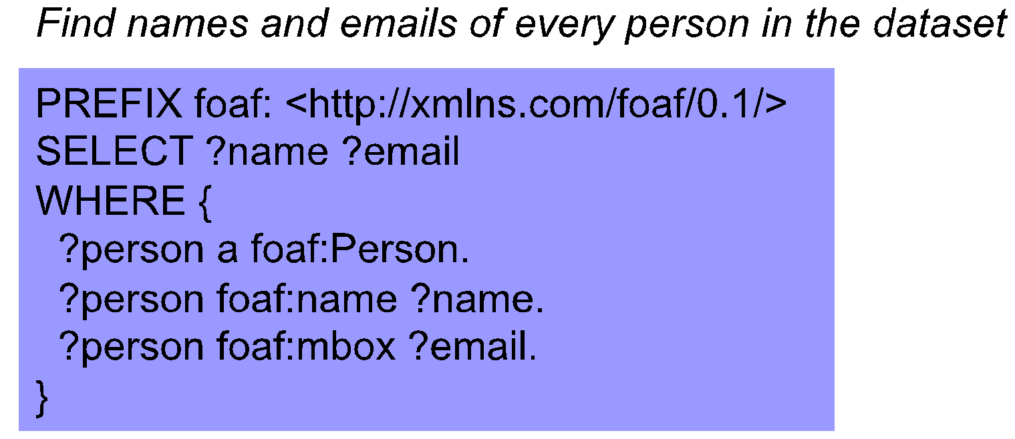
SPARQL
Standardized RDF query language
Tutorial with Examples
Basic functionality quite similar to subgraph pattern matching
But extensions attempt to go bit beyond that

Slide 33
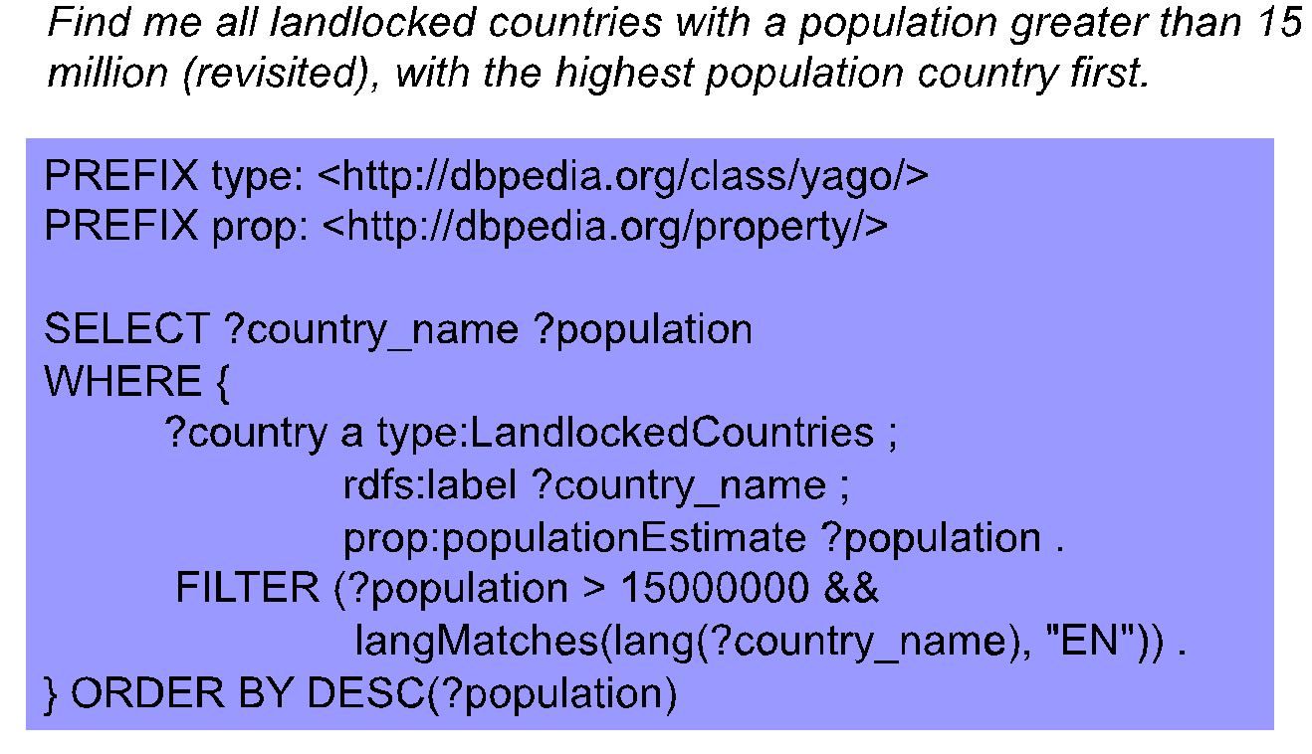
SPARQL

Slide 35
Neo4j
Open-source graph database supported by Neo4j, Inc.
Uses the property graph model
The data is stored on disks (unlike some key-value stores)
Full ACID support (i.e., consistent and reliable updates)
Can scale to billions of nodes and edges
Supports different APIs to access the data
Highly efficient retrieval of nodes of interest through indexing
High performance graph operations
Traverses 1,000,000+ relationships / second on commodity hardware
Support for wide variety of languages
Java, Python, Perl, Scala, Cypher, etc.

Slide 36
Labeled Property Graphs in Neo4j
Nodes:
Main data elements
Connected to other nodes via relationships
Can have one or more properties
Attributes stored as key/value pairs
Relationships:
Connect two nodes
Are directional
Nodes can have multiple, even recursive, relationships
Can have one or more properties

Slide 37
Labeled Property Graphs
Properties:
Named values where the name (or key) is a string
Can be indexed and constrained
Composite indexes can be created from multiple properties
Labels:
Used to group nodes into sets
A node may have multiple labels
Labels indexed to accelerate finding nodes in the graph
Native label indexes optimized for performance

Slide 38
Neo4j Logical Architecture
REST API
Java
Ruby
…
Clojure
JVM Language Bindings
Graph Matching
Core API
Traversal Framework
Caches
Memory-Mapped I/O
Filesystem
Notes:
Filesystem:
- files on disk.
- We lay them out very care so that we can calculate offsets and jump to any record in the files quickly.
- We love SSDs because we can still get stung by spinning disks at this level, but in a second I’ll show how we alleviate that.
- We have separate stores for nodes, relationships, properties, and optimisations for common cases to ensure that data is found in one file (e.g. short strings)
Memory-mapped NIO. We use Java NIO, which is fast!
Caches:
- Our special sauce. Caches allow us to work fast even with spinning disks – they give us millions of traversals per second on laptop-quality hardware
Core API:
- Low level graph abstractions, imperative in nature. Can be highly efficient
- Trade off is low-level programming
Traversal Framework:
- The “query layer”
- We have one stable and one experimental version
- Declaratively describe what to look for in a graph, not so much how.
JVM Language bindings:
- Remember we’re a Java database, so anything can bind to us. We have a Java API, that API has been consumed and adapted to suit JRuby, Jython, Clojure, Scala, etc
REST API:
- A proper, discoverable, hypermedia-driven REST API. Useful if you’re off the JVM or just want to treat the database as a server on the network

Slide 39
Data access is programmatic
Through the Java APIs
JVM languages have bindings to the same APIs
JRuby, Jython, Clojure, Scala…
Managing nodes and relationships
Indexing
Traversing
Path finding
Pattern matching

Slide 40
Core API
Deals with graphs in terms of their fundamentals:
Nodes
Properties
Key-Value Pairs
Relationships
Start node
End node
Properties
Key-Value Pairs

Slide 41
Creating Nodes
GraphDatabaseService db = new EmbeddedGraphDatabase("/tmp/neo");
Transaction tx = db.beginTx();
try {
Node theDoctor = db.createNode();
theDoctor.setProperty("character", "the Doctor");
tx.success();
} finally {
tx.finish();
}
Notes:
All mutating operations on nodes, relationships (and later indexes) must be performed within a transaction.

Slide 42
Creating Relationships
Transaction tx = db.beginTx();
try {
Node theDoctor = db.createNode();
theDoctor.setProperty("character", "The Doctor");
Node susan = db.createNode();
susan.setProperty("firstname", "Susan");
susan.setProperty("lastname", "Campbell");
susan.createRelationshipTo(theDoctor, DynamicRelationshipType.withName("COMPANION_OF"));
tx.success();
} finally {
tx.finish();
}
Notes:
Relationship types can be strings as we’re using here
Or they can be enums if you want the benefits of static typing in your IDE
Either way they’re treated the same by the DB engine – no difference in performance or richness.

Slide 43
Indexing a Graph?
Graphs are their own indexes!
But sometimes we want shortcuts to well-known nodes
Can do this in our own code
Just keep a reference to any interesting nodes
Indexes offer more flexibility in what constitutes an “interesting node”

Slide 44
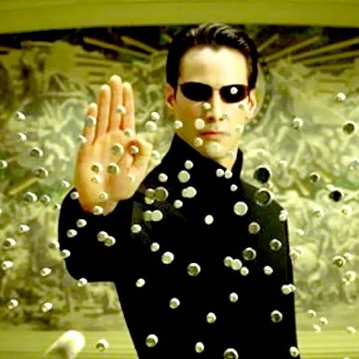

4j
Neo4j and Cypher
Graph database
(Like SQL server, e.g.
PostgreSQL, MySQL)
Implemented in Java
Graph query language for Neo4J (Like SQL)
Declarative

Slide 45
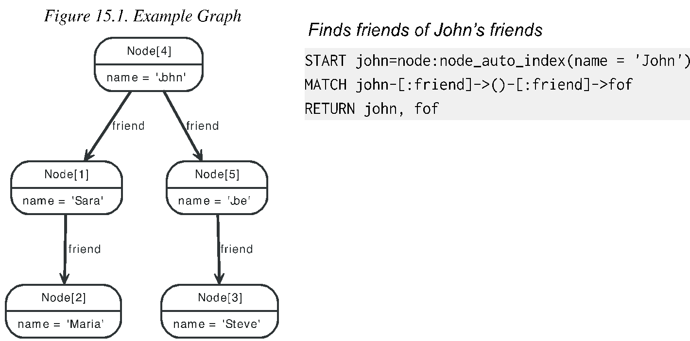
Neo4j
Supports a high-level language, called cypher, for traversing and searching
Source: https://neo4j.com

Slide 46
Neo4j
Can use Cypher on its own (in a console), or in an embedded fashion (e.g., from within Java)
Open sourced Cypher, called openCypher, for standardization by the community of users
Exports an API called BluePrints
BluePrints is analogous to JDBC for relational databases
Several open-source graph toolkits aim to use that API, and thus can be applied directly to data stored in Neo4j
See the Apache TinkerPop web page at http://tinkerpop.apache.org/ for more info on the open source projects

Slide 47
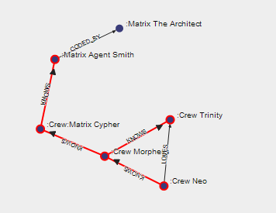
Cypher
https://neo4j.com/

Slide 48

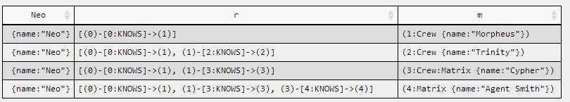
Cypher
https://neo4j.com/

Slide 49
Example Query
The top 5 most frequently appearing companions:
start doctor=node:characters(name = 'Doctor')
match (doctor)<-[:COMPANION_OF]-(companion)
-[:APPEARED_IN]->(episode)
return companion.name, count(episode)
order by count(episode) desc
limit 5
Start node from index
Subgraph pattern
Accumulates rows by episode
Limit returned rows

Slide 50
Results
+-----------------------------------+
| companion.name | count(episode) |
+-----------------------------------+
| Rose Tyler | 30 |
| Sarah Jane Smith | 22 |
| Jamie McCrimmon | 21 |
| Amy Pond | 21 |
| Tegan Jovanka | 20 |
+-----------------------------------+
| 5 rows, 49 ms |
+-----------------------------------+

Slide 51
A general query structure
MATCH [Nodes and relationships]
WHERE [Boolean filter statement]
RETURN [DISTINCT] [statements [AS alias]]
ORDER BY [Properties] [ASC\DESC]
SKIP [Number] LIMIT [Number]

Slide 52
Simple query
Get all nodes of type Program that have the name Hello World!:
Type = Program
Name = ‘Hello World!’
MATCH (a : Program)
WHERE a.name = ‘Hello World!’
RETURN a

Slide 53
Query relationships
Get all relationships of type Author connecting Programmers and Programs:
Type = Programmer
Type = Program
Author
MATCH (a : Programmer)-[r : Author]->(b : Program)
RETURN r

Slide 54
Matching nodes and relationships
Nodes:
(a), (), (:Ntype), (a:Ntype),
(a { prop:’value’ } ) , (a:Ntype { prop:’value’ } )
Relationships:
(a)--(b)
(a)-->(b), (a)<--(b),
(a)-->(), (a)-[r]->(b), (a)-[:Rtype]->(b), (a)-[:R1|:R2]->(b), (a)-[r:Rtype]->(b)
May have more than 2 nodes:
(a)-->(b)<--(c), (a)-->(b)-->(c)
Path:
p = (a)-->(b)

Slide 55
More options
Relationship distance:
(a)-[:Rtype*2]->(b) – 2 hops of type Rtype.
(a)-[:Rtype* ]->(b) – any number of hops of type Rtype.
(a)-[:Rtype*2..10]-> (b) – 2-10 hops of Rtype.
(a)-[:Rtype* ..10]-> (b) – 1-10 hops of Rtype.
(a)-[:Rtype*2.. ]-> (b) – at least 2 hops of Rtype.
Could be used also as:
(a)-[r*2]->(b) – r gets a sequence of relationships
(a)-[*{prop:val}]->(b)

Slide 56
Operators
• Mathematical
+, -, *, /,%, ^ (power, not XOR)
• Comparison
=,<>,<,>,>=,<=, =~ (Regex), IS NULL , IS NOT NULL
• Boolean
AND, OR, XOR, NOT
• String
Concatenation through +
• Collection
Concatenation through +
IN to check if an element exists in a collection

Slide 57
More WHERE options
WHERE others.name IN ['Andres', 'Peter']
WHERE user.age IN range (18,30)
WHERE n.name =~ 'Tob.*‘
WHERE n.name =~ '(?i)ANDR.*‘ - (case insensitive)
WHERE (tobias)-->()
WHERE NOT (tobias)-->()
WHERE has(b.name)
WHERE b.name? = 'Bob'
(Returns all nodes where name = 'Bob' plus all nodes without a name property)

Slide 58
Functions
On paths:
MATCH shortestPath( (a)-[*]-(b) )
MATCH allShorestPath( (a)-[*]-(b) )
Length(path) – The path length or 0 if not exists.
RETURN relationships(p) - Returns all relationships in a path.
On collections:
RETURN a.array, filter(x IN a.array WHERE length(x)= 3)
FILTER - returns the elements in a collection that comply to a predicate.
WHERE ANY (x IN a.array WHERE x = "one“ ) – at least one
WHERE ALL (x IN nodes(p) WHERE x.age > 30) – all elements
WHERE SINGLE (x IN nodes(p) WHERE var.eyes = "blue") – Only one
* nodes(p) – nodes of the path p

Slide 59
With
Manipulate the result sequence before it is passed on to the following query parts.
Usage of WITH:
Limit the number of entries that are then passed on to other MATCH clauses.
Introduce aggregates which can then be used in predicates in WHERE.
Separate reading from updating of the graph. Every part of a query must be either read-only or write-only.

Slide 60
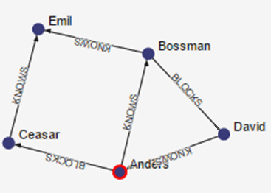
With
MATCH (david { name: "David" })--(otherPerson)-->()
WITH otherPerson, count(*) AS foaf
WHERE foaf > 1
RETURN otherPerson
What will be returned?
The person connected to David with more than one outgoing relationship.
(2 {name:"Anders"})
* foaf = 2
Notes:
Similar to SQL GROUP BY

Slide 61
More collections options
MATCH (user)
RETURN count(user)
MATCH (user)
RETURN count(DISTINCT user.name)
MATCH (user)
RETURN collect(user.name)
Collection from the values, ignores NULL.
MATCH (user)
RETURN avg(user.age)
Average numerical values. Similar functions are sum, min, max.

Slide 62
More Neo4j info
Neo4j manual:
http://neo4j.com/docs/stable/
Cypher tutorials:
http://neo4j.com/developer/cypher-query-language/
Neo4j developers tutorials:
http://neo4j.com/developer/get-started/

